Slide 1

STATE MANAGEMENT
From@brian

Slide 2
Out line
State management review
Some of pattern
Project style in scale
Disscussion
Some of knowlegde from NAB
Notes:
React and visual automata-based programming | Łukasz Makuch (coder.earth)
State management in JavaScript: data-related state and behavior-related state | Łukasz Makuch (coder.earth)

Slide 3
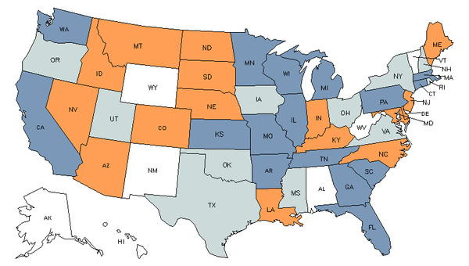
>/ What is state Management?
This Photo by Unknown Author is licensed under CC BY

Slide 4
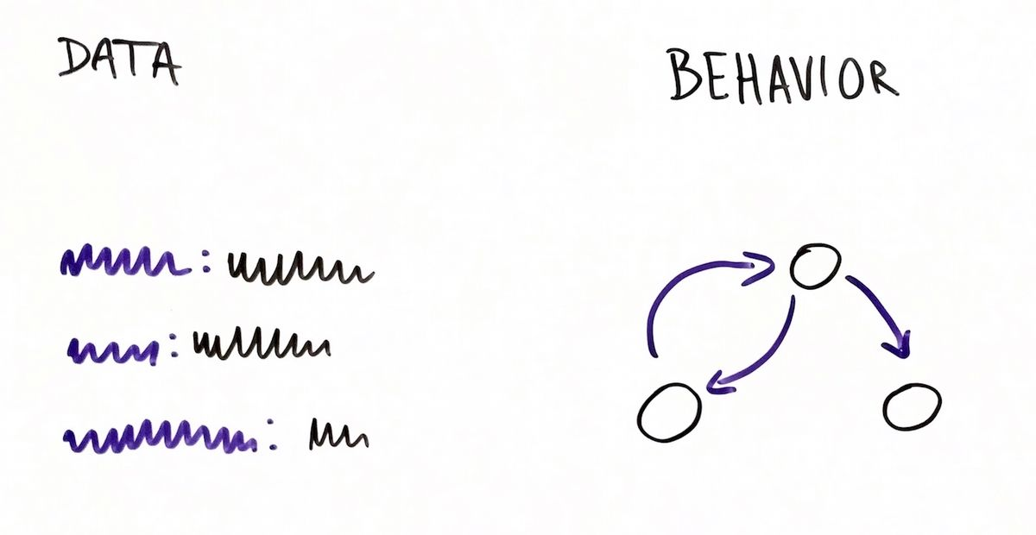

Slide 5

Summon your spells
immutable data structures
mutations
stored in one place
distributed among many objects.
pulling
Hollywood-like (push) solutions which actually call us.
This Photo by Unknown Author is licensed under CC BY-NC-ND
Notes:
This is common concept when we are talking about state management

Slide 6
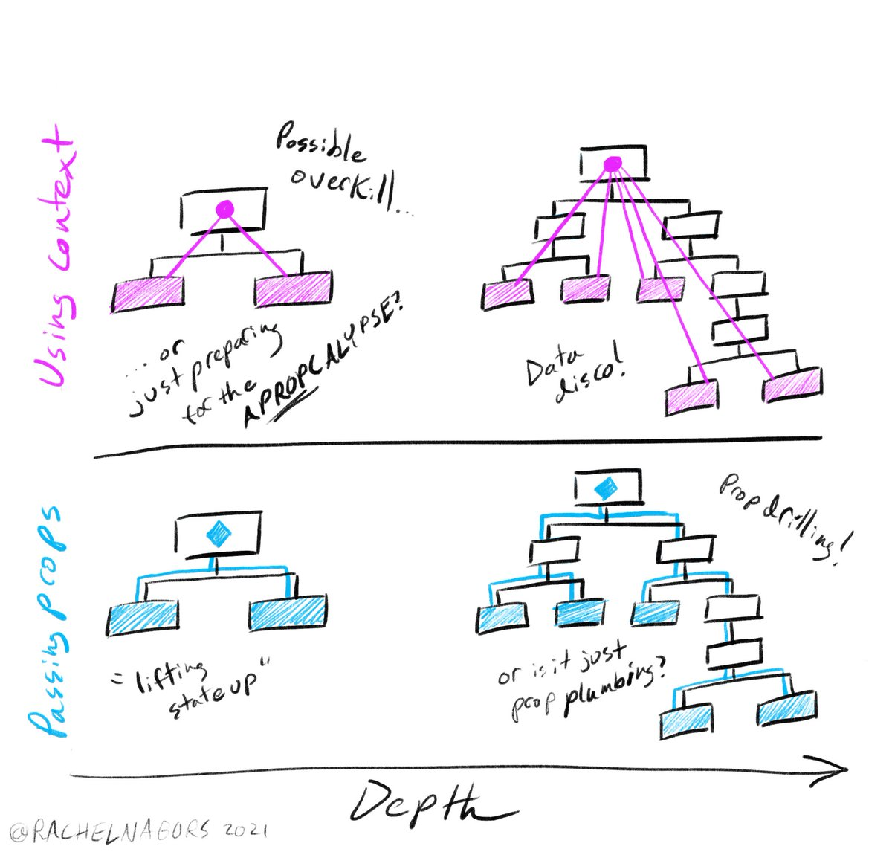
Context vs Props not Drilling
Notes:
In order to illustrate my concerns, I'd like show you yet another whiteboard drawing.
In this picture I captured all the main screens of a wizard-like application as well as the events which make one screen change to another.
To put it another way, it's about behavior-related state.
React and visual automata-based programming | Łukasz Makuch (coder.earth)

Slide 7
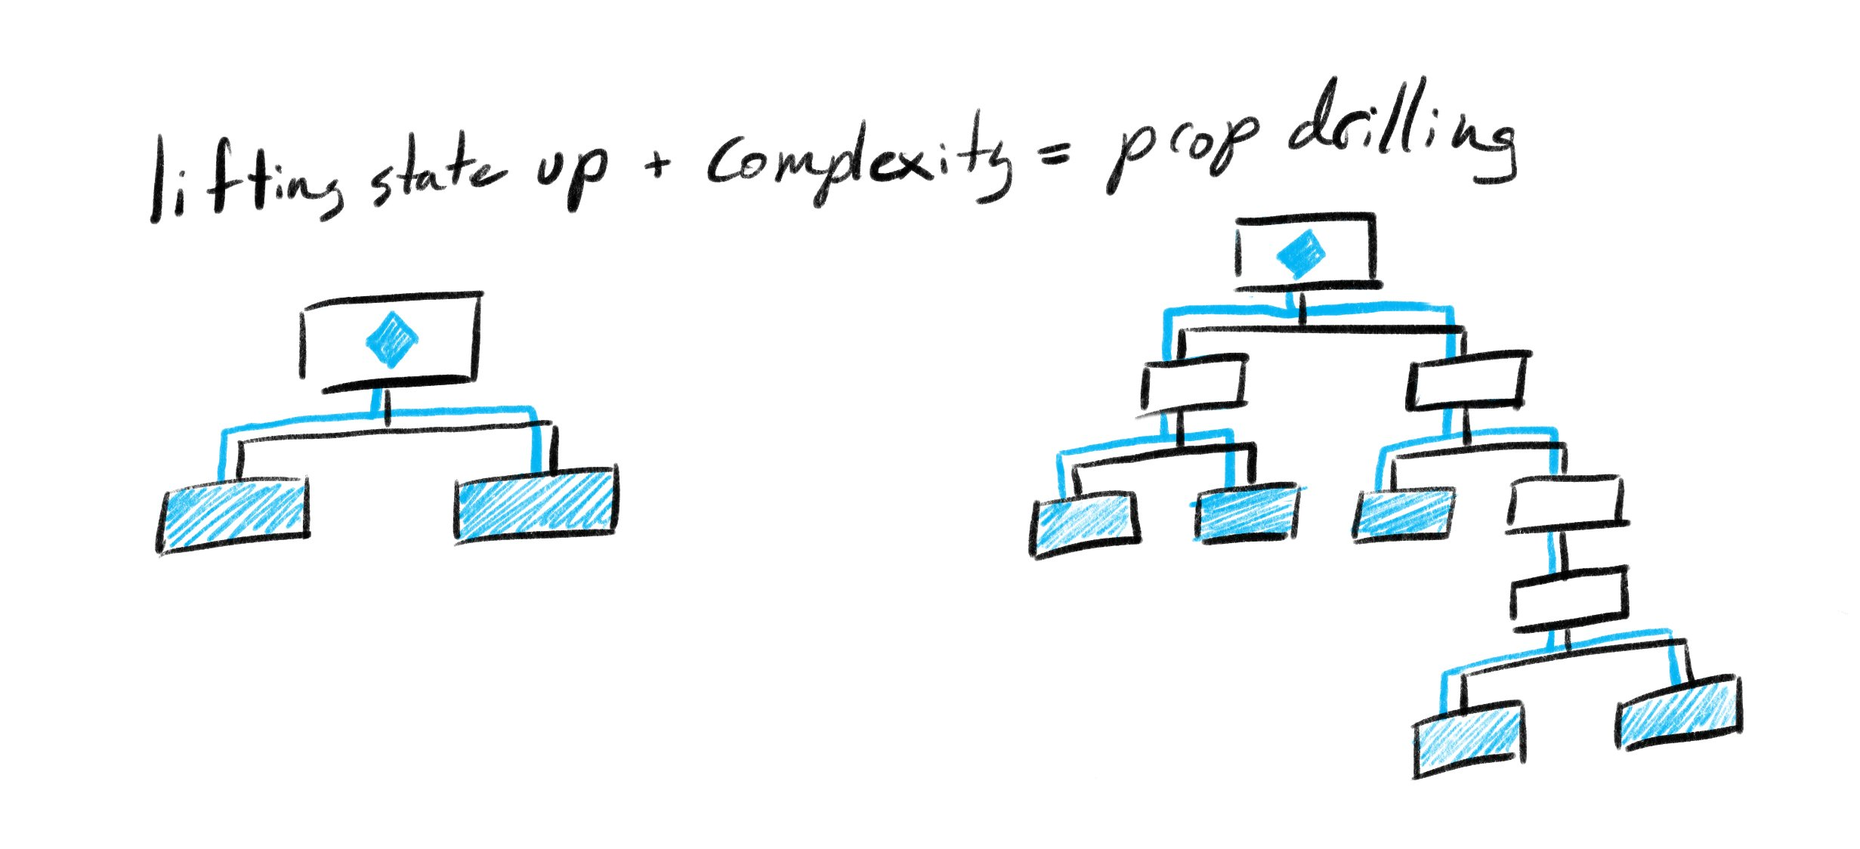
💀 Anti pattern

Slide 8


STATE
STATE
STATE
STATE
STATE
STATE
STATE
STATE
STATE
Notes:
Nếu đa vũ vụ song song và có thứ bậc thì

Slide 9
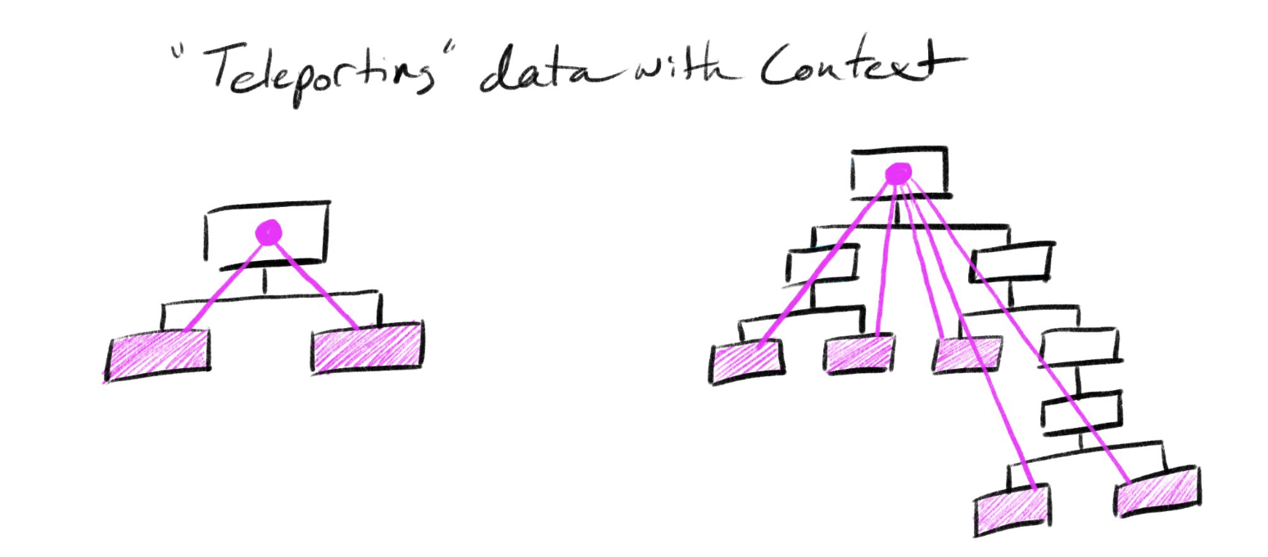
🪄Teleport Spell

Slide 10
Context API vs Redux
A single of truth is core of ______. That can only be accessed and manipulated in very specific, predefined ways. Then data manipulation through _______ is very controlled and consistent. Additionally, ________ enables the use of powerful middleware libraries. That inherited ________(S,O,L,I,D) principle.
The introduction of _____ has transformed the landscape of React state management. Gone are the days of deciding between prop drilling with plain React or making the significant time investment to set up _____. Context now represents a much needed solution to prop drilling that is quick and easy to implement. However, as the complexity and scale of the app increases and as performance becomes a higher concern, ______ remains the tried-and-true solution
Notes:
Fortunately, React 16.3 introduces the concept of Context which helps to greatly alleviate the messiness of prop drilling
Through the use of the Context Provider and Consumer APIs, app state can be accessed from within any component, regardless of how many levels it is nested, without that data being passed in from a parent component.
Additionally, parent components which would typically need access to app state in order to pass data down to child components can now remain completely unconcerned about app state.
As a result, less components become tightly-coupled together, and more components can remain flexible and much more reusable.
Additionally, Redux enables the use of powerful middleware libraries. Redux-sagas, for example, provides the ability to perform redux functions asynchronously, which comes in very handy when making API calls. Middleware like this proves to be very useful in solving complex problems and can result in significant performance increases and UX improvements over Context.
The introduction of Context has transformed the landscape of React state management. Gone are the days of deciding between prop drilling with plain React or making the significant time investment to set up Redux. Context now represents a much needed solution to prop drilling that is quick and easy to implement. However, as the complexity and scale of the app increases and as performance becomes a higher concern, Redux remains the tried-and-true solution.

Slide 11
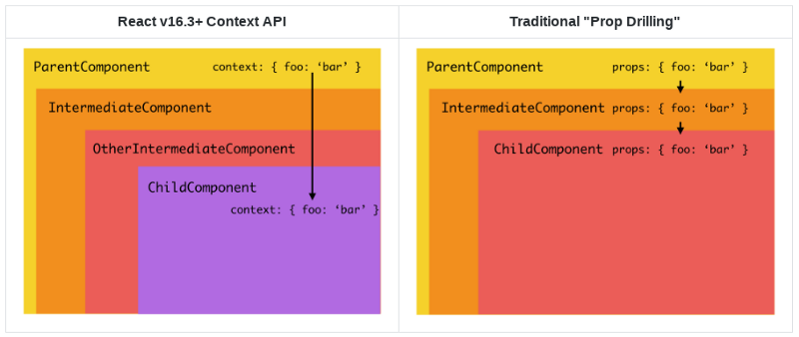
SUM-MARY

Slide 12
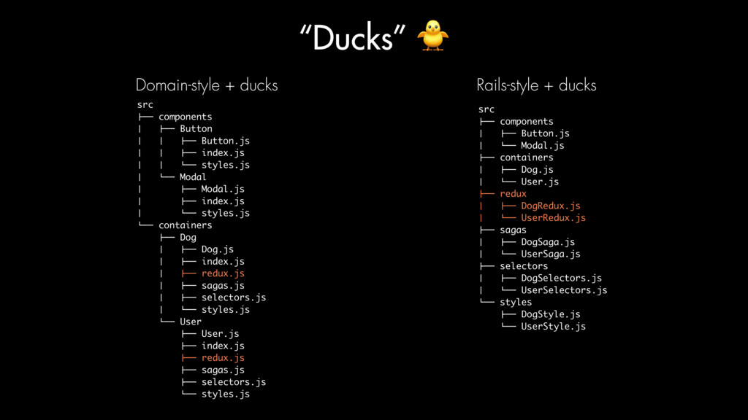
Rails-style, Domain-Style, and Ducks
Files -> Features -> Ducks
Notes:
app size and complexity,
long-term scalability,
simply personal preference
Rails-style
The Rails-style convention of code structure suggests that code should be separated into files within function-specific folders such as Components, Actions, Reducers, Middleware, etc. The resulting folder structure resembles the way in which many Rails projects are organized into function-specific folders for Models, Views, and Controllers. This design pattern suffices for smaller projects, but as apps grow, each of these folders can quickly become unwieldy. Each folder could contain dozens, potentially even hundreds, of files which becomes very difficult to manage.
Domain-style
A domain-style design pattern helps to address the issue of bloated, unmanageable, Rails-style folders by organizing files into folders based on app features such as User, Post, Order, etc. All files regarding Orders, for example, would be located within the Order folder, and that folder would then contain files for Order related components, actions, reducers, and helper functions. This file structure allows for quick access to relevant files when working on specific app features, and eliminates the need to search through large, cluttered folders and files.
Ducks pattern
While the domain-centric pattern is a big step in the right direction, our dev team at SmartLogic has found the Ducks pattern to be an even more effective way to organize our code. As in the domain-style convention, code is organized based on features of the app. The "ducks" pattern, however, combines the actions, action type constants, and reducers into a single redux file.
This consolidation of Redux-specific code leads to leaner project directories which has proved to be very beneficial as our apps grow. Additionally, when working on redux-related code, less files need to be touched. These benefits normally come at a cost, though. Combining actions, action type constants, and reducer logic could potentially result in very large redux files.

Slide 13
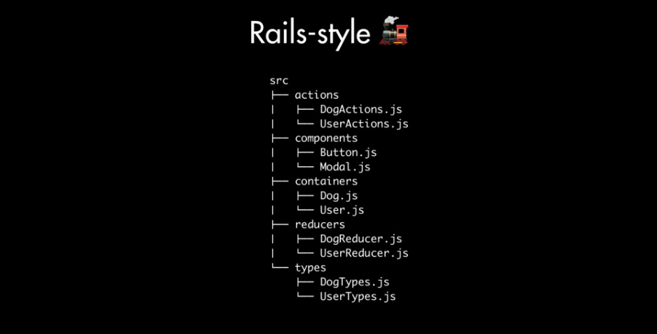

Slide 14
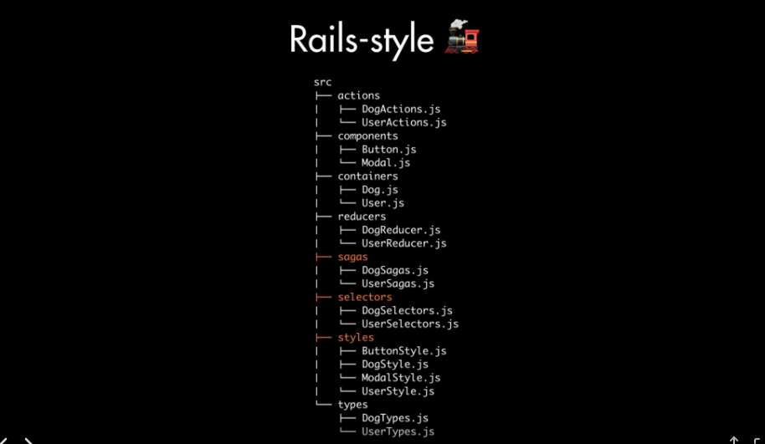

Slide 15
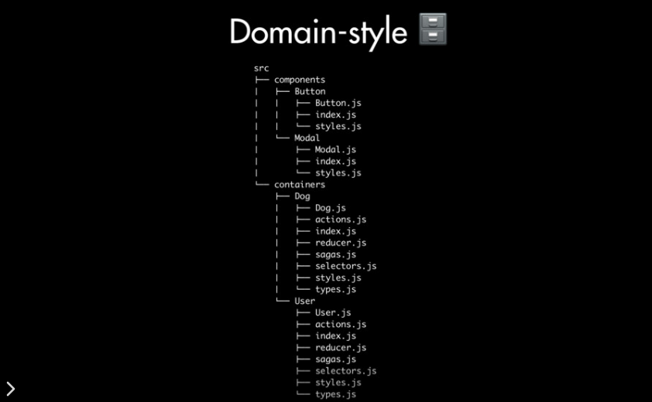

Slide 16
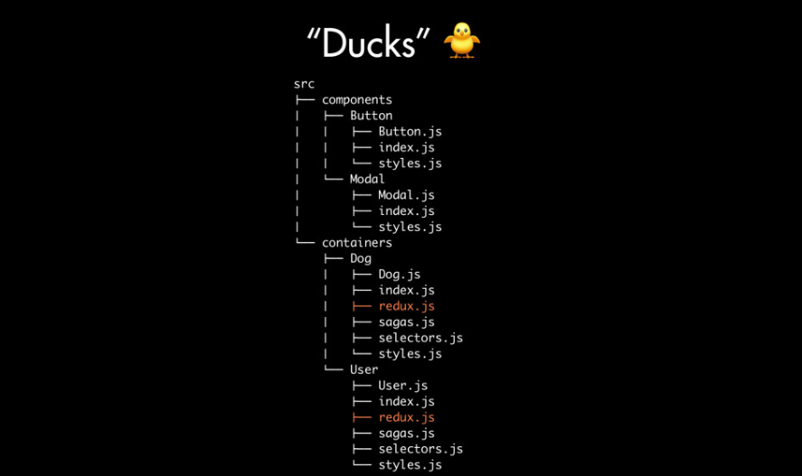

Slide 17
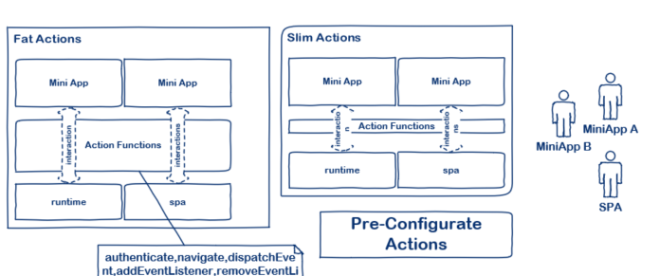
FAT AND SLIM ACTIONS

Slide 18
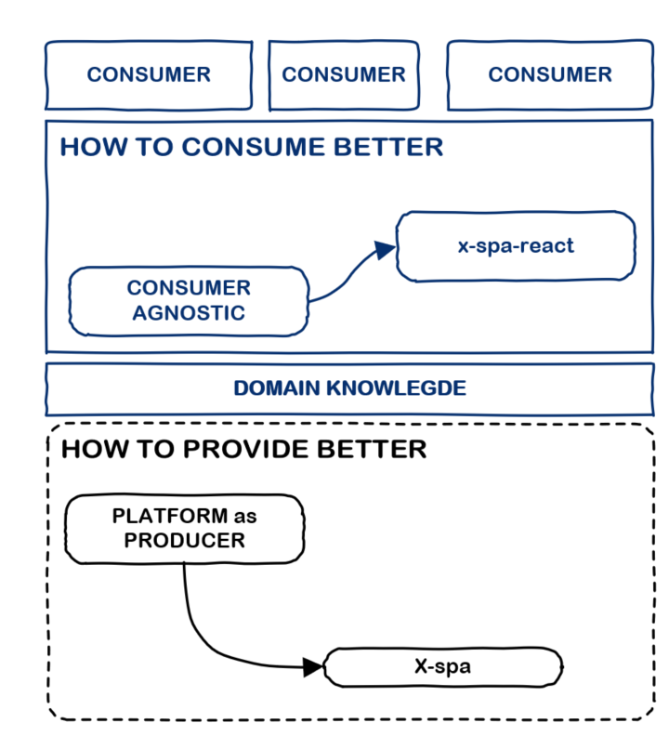
SEPARTE OF CONCERN CONSUMNER && PRODUCER
Notes:
Init spa with patchHistory?? With shellServices was declared we create and set up for SPA.
Loader can be XV1Apploader or XV2Apploader
Init as baseInit was invoked from consumer

Slide 19
Thanks, you

